Slide 1
FY2022 Open Recalls
APM-400 Property Operations Division
Fleet National Program Office

Slide 2
FY2022 Open Recalls
Recall Type | Count of Recalls
NonSafety | 352
Safety | 454
Warranty | 751
Grand Total | 1557

Slide 3
Recall KSN Background
preferred method for collecting information about vehicle recalls for FAA owned and leased vehicles
lists all current recalls for the fiscal year, as reported by the Department of Transportation National Highway Transportation Safety Administration (NHTSA)
easily see and update the status of the recalls on FAA vehicles

Slide 4
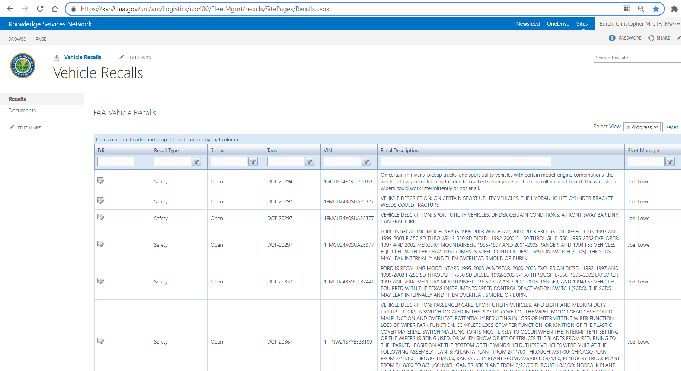
Recall KSN
https://ksn2.faa.gov/arc/arc/Logistics/alo400/FleetMgmt/recalls

Slide 5
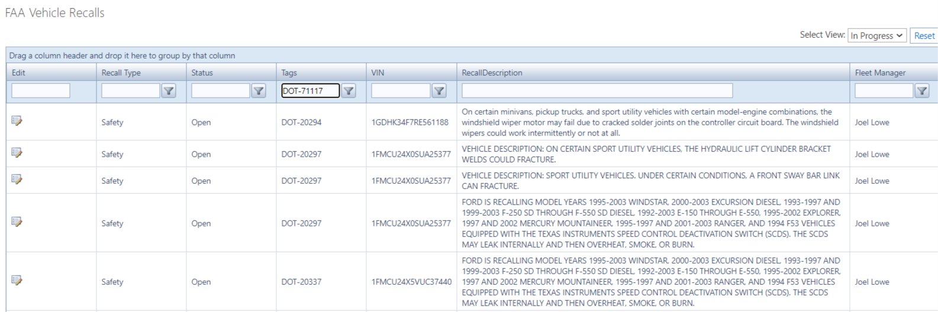
Recall KSN – Searching by Tag
Type the vehicle tag into the text bar under ‘Tags’

Slide 6
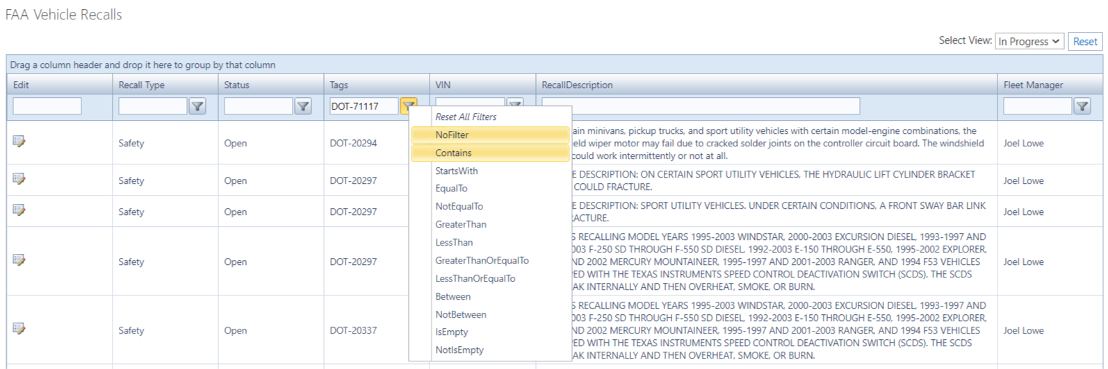
Recall KSN – Searching by Tag
Click the filter icon and select ‘Contains’ from the menu

Slide 7
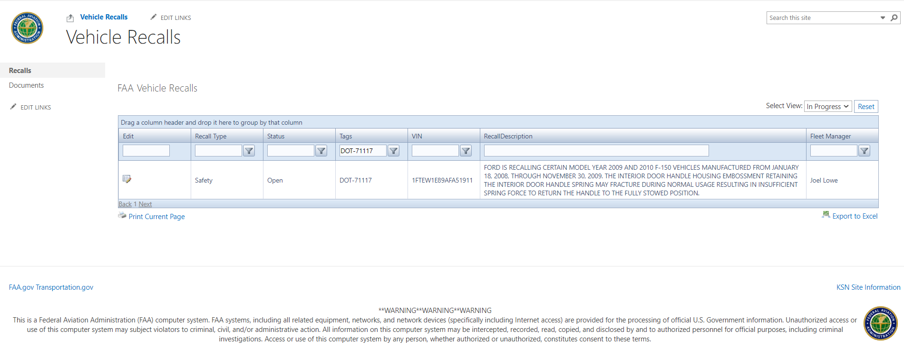
Recall KSN – Searching by Tag
The list is now filtered to show only that vehicle tag

Slide 8
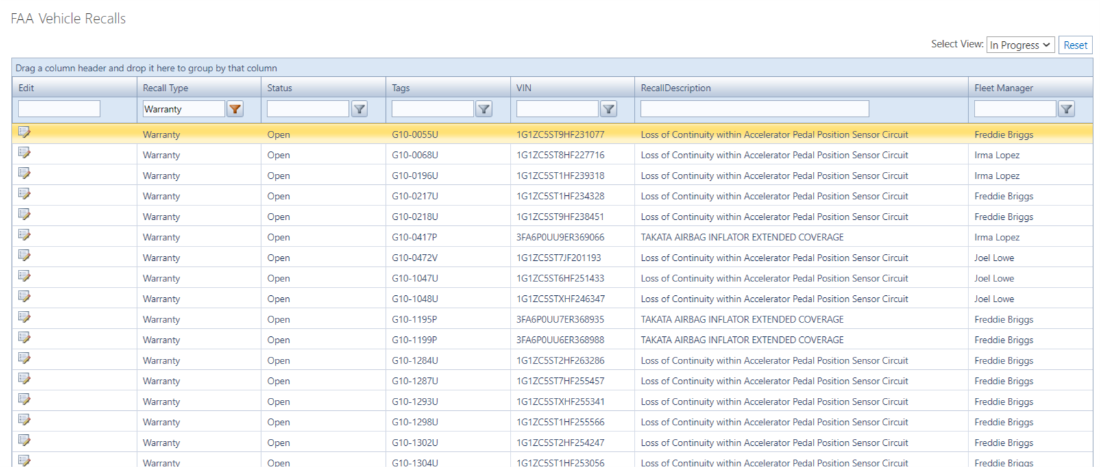
Recall KSN - Editing
Click the edit icon for the recall entry you want to update

Slide 9
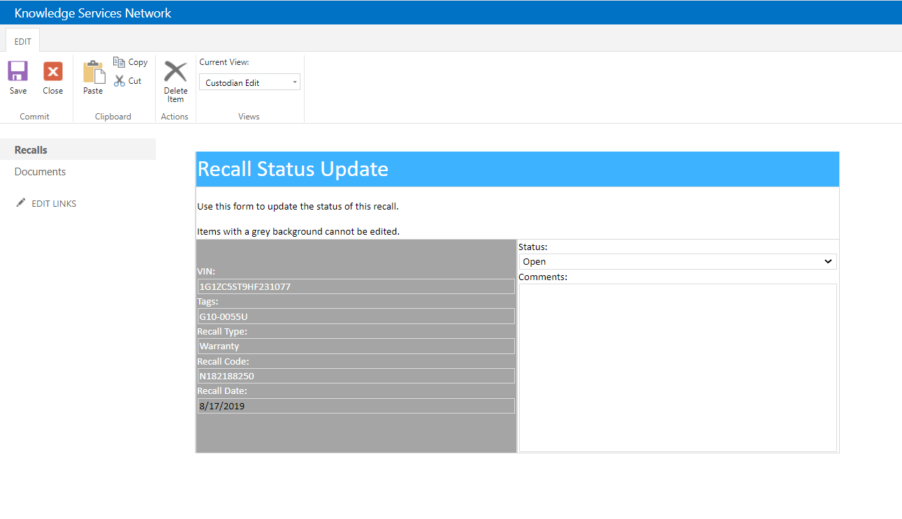
Recall KSN – the Status Update Form
Grey boxes with white text cannot be edited

Slide 10
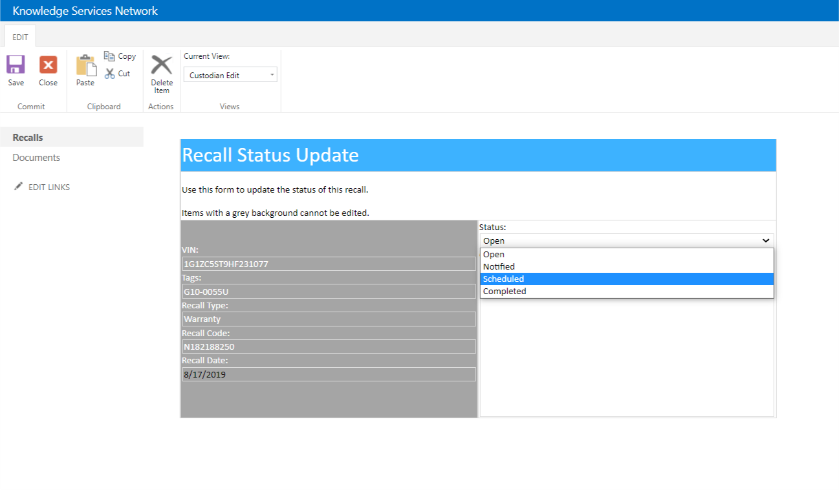
Recall KSN – the Status Update Form
1. Choose the new status from the dropdown menu
2. Enter any comments – scheduled date, etc

Slide 11
Recall KSN – the Status Update Form
3. Make sure to click Save!

Slide 12
Recall KSN

